Slide 1
Prospect of intelligent transport system (ITS) in Bangladesh to reduce traffic congestion and energy wastage
Author: Fardeen Hasib Mozumder

Slide 2
Overview
Traffic congestion is one of the biggest problems that the citizens of Dhaka face daily.
Dhaka ranked 10th in terms of poor traffic management among 228 cities in the World Traffic Index 2020.
In this work, we will try to address this challenge using Intelligent traffic system fueled by AI.

Slide 3
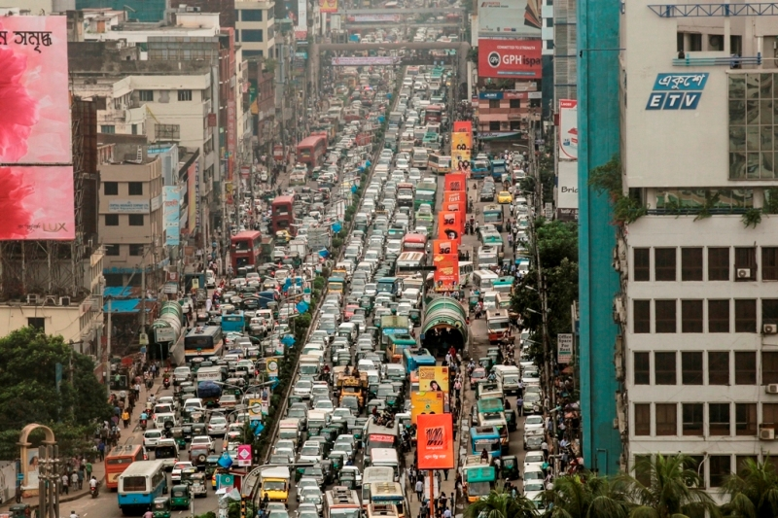

Slide 4
Affects of Heavy Traffic Congestion in Bangladesh
Economic Loss:
The economy lost Tk 56,000 crore ($6.5 billion) in 2020 from traffic, according to the Accident Research Institute (ARI) of Bangladesh University of Engineering and Technology (BUET).
The study estimated that people waste 19 million working hours per day.
The study also found that 40% of additional fuel is burned daily due to traffic congestion.
The economic value of this additional fuel is Tk 4.2 crore.

Slide 5
Affects of Heavy Traffic Congestion in Bangladesh
Health Condition Deterioration:
According to the most recent World Health Organization data, the air quality in Dhaka reaches a yearly average of 168 –which is classified as “unhealthy”.
In the South Asia region, more than 2.1 million people died due to air pollution where Bangladesh is third.
In 2019, some 173,500 people died from diseases caused by air pollution.
Obesity among youth increases.

Slide 6
Affects of Heavy Traffic Congestion in Bangladesh
In nutshell, traffic jams in Bangladesh pose significant challenges to the economic growth, environmental sustainability, and public health of the country.
So, it is extremely important to find a feasible solution which can address this issue in an effective manner.

Slide 7
Solution
Intelligent Transport System (ITS)

Slide 8
ITS (Intelligent Transport System)
An advanced system that utilizes technology to manage traffic flow, reduce congestion, and enhance road safety.
Components:
Sensors: gather real-time data about traffic volume, speed, and density.
Communication Systems: facilitate information exchange between vehicles, infrastructure, and traffic management centers.
Control Systems: analyze data and adjust traffic signals, speed limits, and lane assignments to optimize traffic flow.

Slide 9
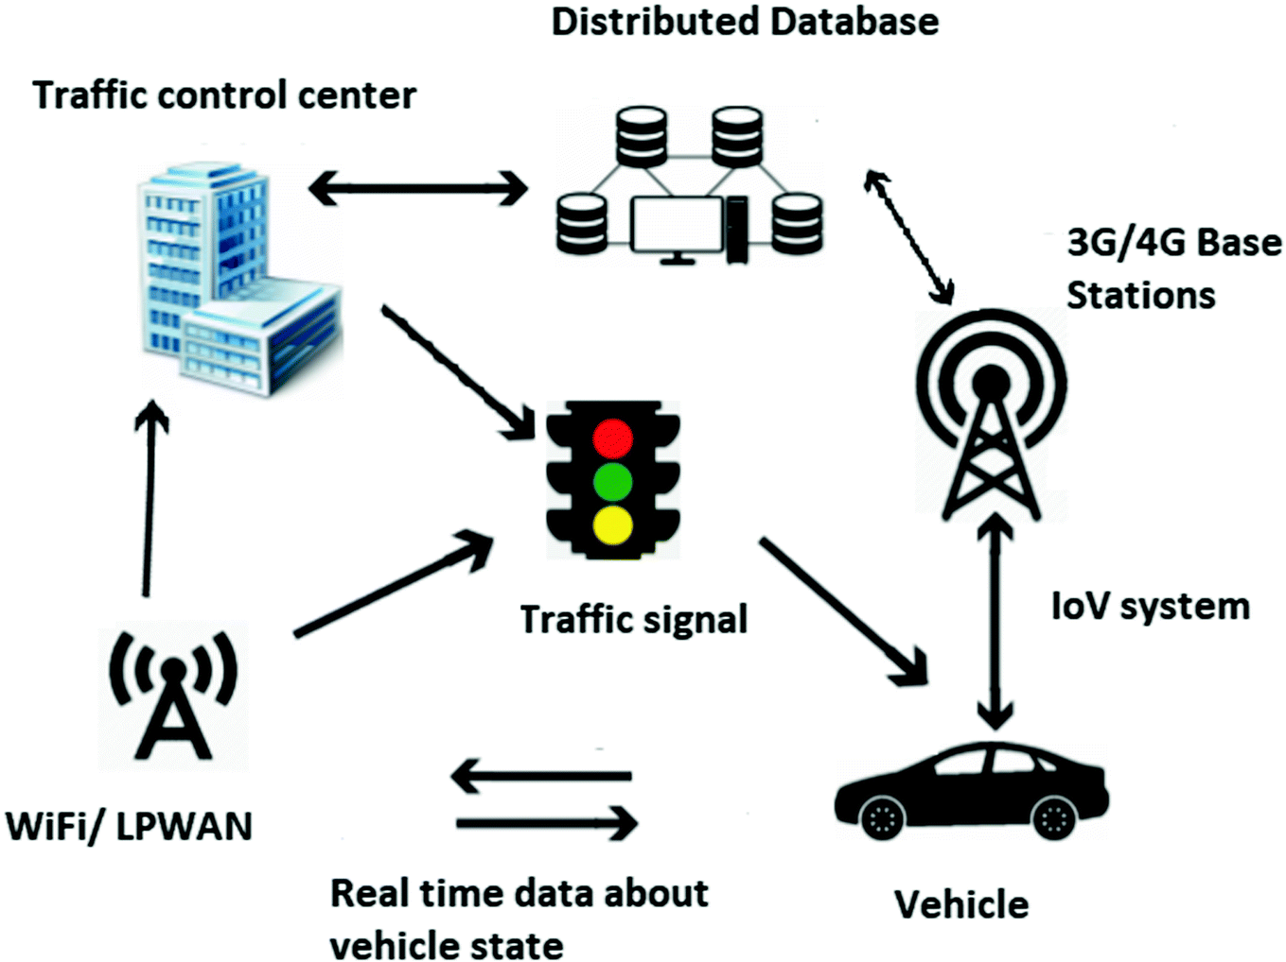
ITS explained

Slide 10
Few Applications of ITS
Adaptive Traffic Control Systems (ATCS): adjust traffic signal timing based on real-time traffic data.
Intelligent Speed Adaptation (ISA): automatically adjust vehicle speed by setting speed limits depending on road conditions.
Electronic Toll Collection (ETC): enables tolls to be collected electronically, reducing congestion at toll plazas.

Slide 11
Why Adaptive Traffic control Systems and Benefits
Directly associated with solving traffic congestion.
No point of flashing red light/stopping vehicles when other lanes are free.
No point of flashing green light/allowing traffic flow when the lane is empty.
Observe real time traffic data and make optimized decision instantaneously.

Slide 12
Flowchart of an ATCS Model
Start
Capture Real Time Traffic Images
Efficient Object Detection Technique
Acquire Current Traffic Density
Apply optimal traffic control policy
Change Traffic Signal using the Policy

Slide 13
Object Detection Technique
The object detection model will be used to determine the real time traffic density by detecting the vehicles present on the road.
An efficient object detection model is required to accurately identify different types of vehicles to make calculated decision.
For example, a fast vehicle (like cars, bus) vs a slow vehicle (cycle, rickshaw).

Slide 14
Proposed Object Detection Method
To do….
Apply yolov7 on Dhaka.ai dataset. Currently, the board leader used yolov5 model. If yolov7 gives a better result, which it should, then show the comparison

Slide 15
Proposed Traffic Light Control Policy
For this work, we proposed to use a deep reinforcement model, DQN (Deep Q Learning) to change the traffic light depending on the traffic density.
Simulation results show that the proposed model reduces traffic congestion better than the conventional fixedtime method and SOTL (Self Organizing Traffic Control) method.

Slide 17
Traffic Simulation with Fixedtime Method
Traffic Simulation with DQN Method
Traffic simulation with SOTL
Method
Traffic Simulation with SOTL

Slide 18
Our proposed ATCS Model
Start
Capture Real Time Traffic Images
Object Detection using YOLOv7
Acquire Current Traffic Density
Traffic control policy using DQN
Change Traffic Signal using the Policy

Slide 19
Benefits of our model
Dataset availability.
Easy to implement than using magnetic sensors, cause road renovation needed.
Cost effective.
Highly scalable cause once the algorithm is ready, all we need are cameras and internet connection.

Slide 20
Feasibility
Several countries in Asia have implemented Adaptive Traffic Control Systems (ATCS) to manage traffic flow and reduce congestion. Here are some examples:
China: China has been a leader in implementing ATCS technology. Cities like Beijing, Shanghai, and Guangzhou have implemented ATCS to manage traffic flow and reduce congestion.
Japan: Japan has been at the forefront of developing and implementing intelligent transportation systems, including ATCS. Cities like Tokyo and Yokohama have implemented ATCS to optimize traffic flow and reduce congestion.
South Korea: South Korea has also implemented ATCS technology in cities like Seoul and Busan, to improve traffic management and reduce congestion.
Singapore: Singapore has implemented an advanced Intelligent Transport System (ITS) that includes ATCS, to manage traffic flow and optimize travel times.
India: Several cities in India, including Mumbai, Delhi, and Hyderabad, have implemented ATCS technology to improve traffic management and reduce congestion.

Slide 21
Conclusion
Intelligent Traffic Systems (ITS) can play an important role in achieving inclusive growth for a country by improving the efficiency, safety, and accessibility of transportation infrastructure. Here are some ways that ITS can contribute to inclusive growth:
Improved mobility: ITS can help to improve the mobility of all citizens, including those with disabilities or limited access to transportation. By providing real-time traffic information and optimizing traffic flow, ITS can help to reduce travel times and increase the accessibility of transportation options.
Enhanced safety: ITS can help to improve the safety of transportation infrastructure by reducing accidents and increasing the responsiveness of emergency services. For example, traffic cameras and sensors can be used to detect accidents and alert emergency services, while real-time traffic information can be used to divert traffic away from accident sites.
Increased economic opportunities: By reducing congestion and improving the efficiency of transportation infrastructure, ITS can help to increase economic opportunities for businesses and individuals. This can include reducing delivery times, improving access to markets, and increasing the competitiveness of local industries.
Environmental sustainability: ITS can help to reduce the environmental impact of transportation infrastructure by optimizing traffic flow, reducing emissions from idling vehicles, and promoting the use of alternative modes of transportation such as public transit, biking, and walking.
Overall, ITS can contribute to inclusive growth by improving mobility, enhancing safety, increasing economic opportunities, and promoting environmental sustainability. By creating more accessible, efficient, and sustainable transportation infrastructure, ITS can help to create a more equitable and prosperous society for all citizens.

Slide 22
Credits
Add your credits here

